Slide 1
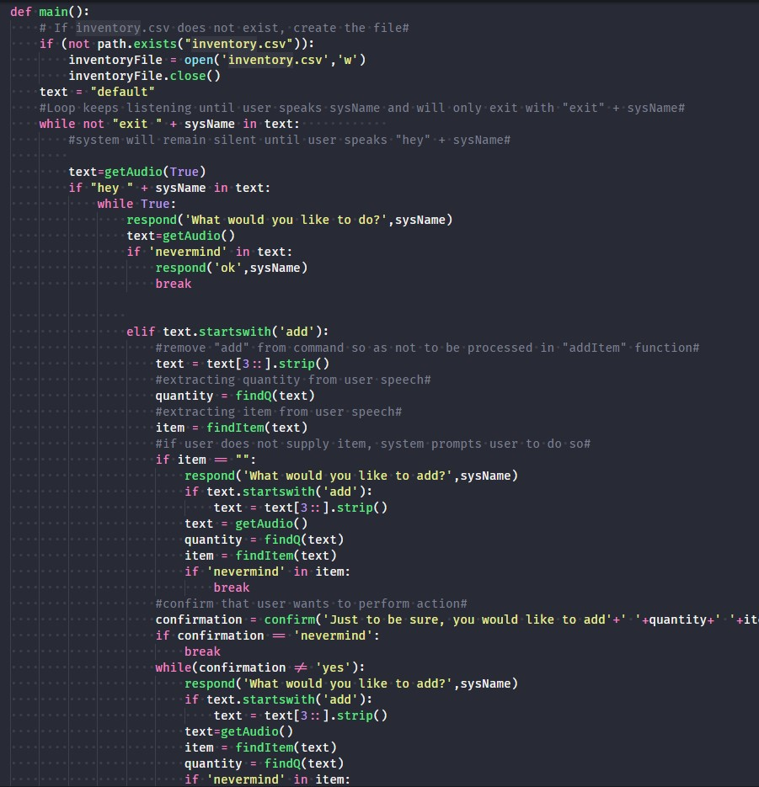


Voice-Activated Kitchen Assistant talk to your “kitchen”
“Hey, Kitchen.”
Michael Friedel
Baron Wasden

